Slide 1
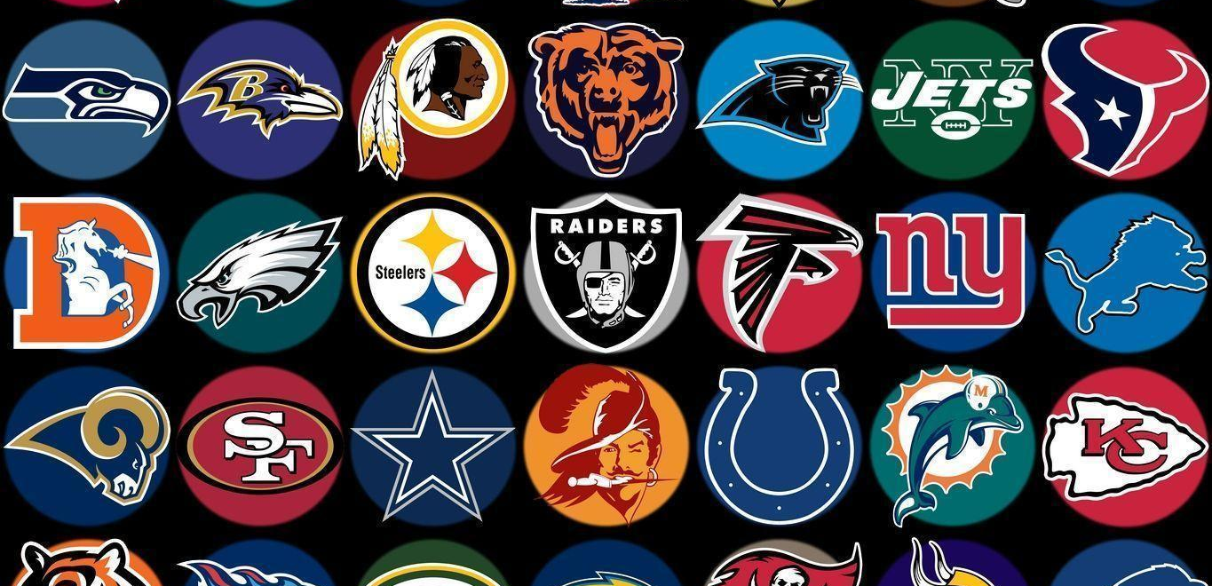
Hierarchical Clustering Analysis on Offensive Skill Positions in the NFL
By. Alejandro Pesantez
Notes:
https://wallpapercave.com/nfl-teams-wallpaper-2017

Slide 2

About ME:
Currently getting a M.S in Data Science at the University of Notre Dame
Graduated from Syracuse University last spring with a B.S in Sport Analytics and a B.A in Economics with a minor in Information and Management.
This past fall worked as a Football Video Scout at Sports info Solutions
Played football from 3rd grade up until my senior year of high school

Slide 3
My THESIS: Overview
Analyze the value of offensive skill positions
Broke down Quarterbacks, Running Backs, and Receivers into player types
Compared each player type to Win Probability Added

Slide 4

The Data
The first dataset obtained was from pro-football-reference.com
Variables: Team, Season, and Win Percentage
Spans from 2009-2017
Next two datasets were retrieved from the nflScrapR GitHub
Roster Dataset variables: GSIS_ID, Position, and Team
Season Player Stats Dataset included rushing, passing, and receiving variables.
Didn’t Include position and team
Merged all three datasets together by GSIS_ID
Broke up the data into three datasets (Quarterbacks, Running Backs, Wide Receivers)

Slide 5
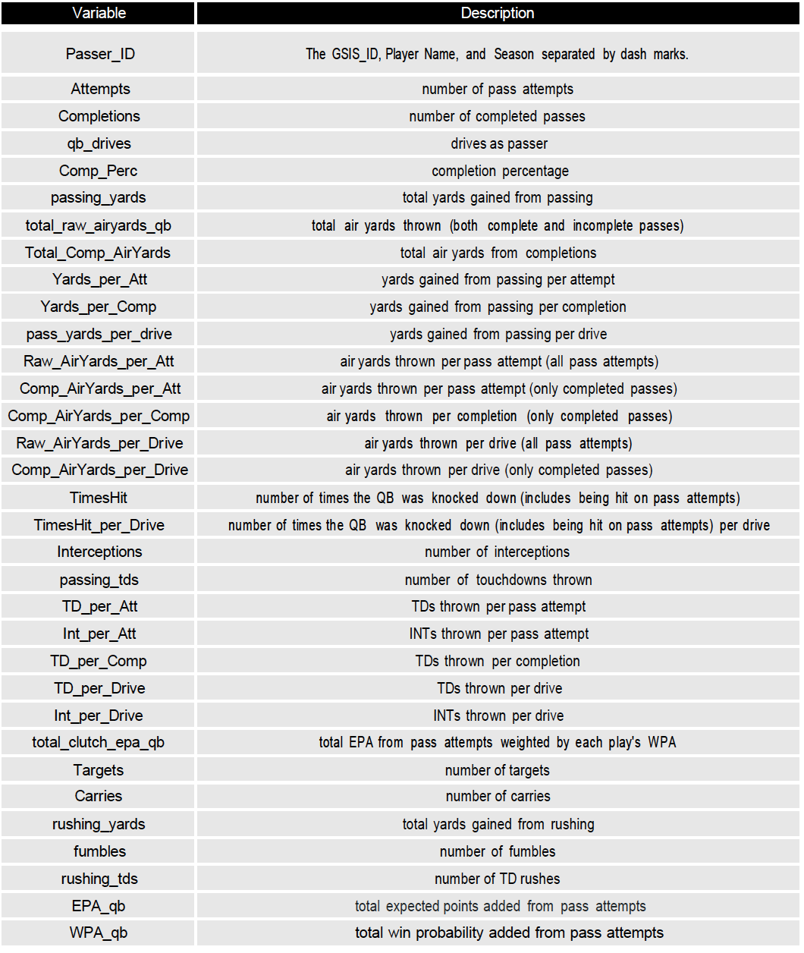

Quarterback Dataset
645 observations by 33 variables
Each observations is a player season
EX: 2013 Tom Brady is one observation
Spans from 2009-2017 seasons

Slide 6
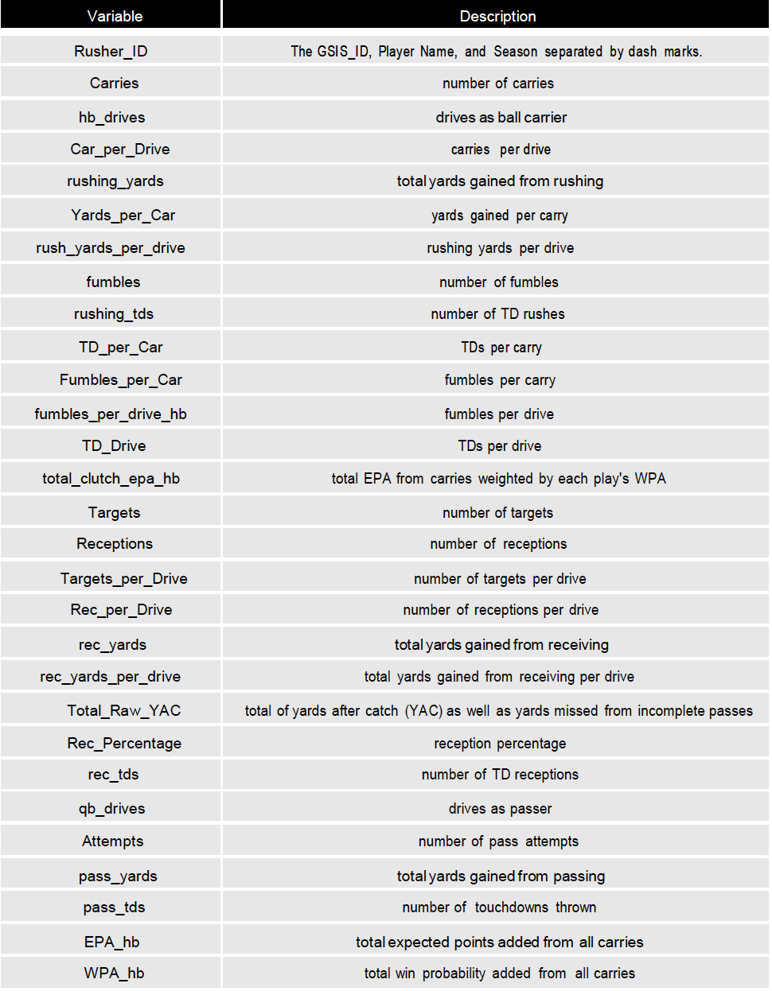
Running Back Dataset
1,208 observations by 29 variables
Each observations is a player season
EX: 2014 Jonas Gray is one observation
Spans from 2009-2017 seasons

Slide 7
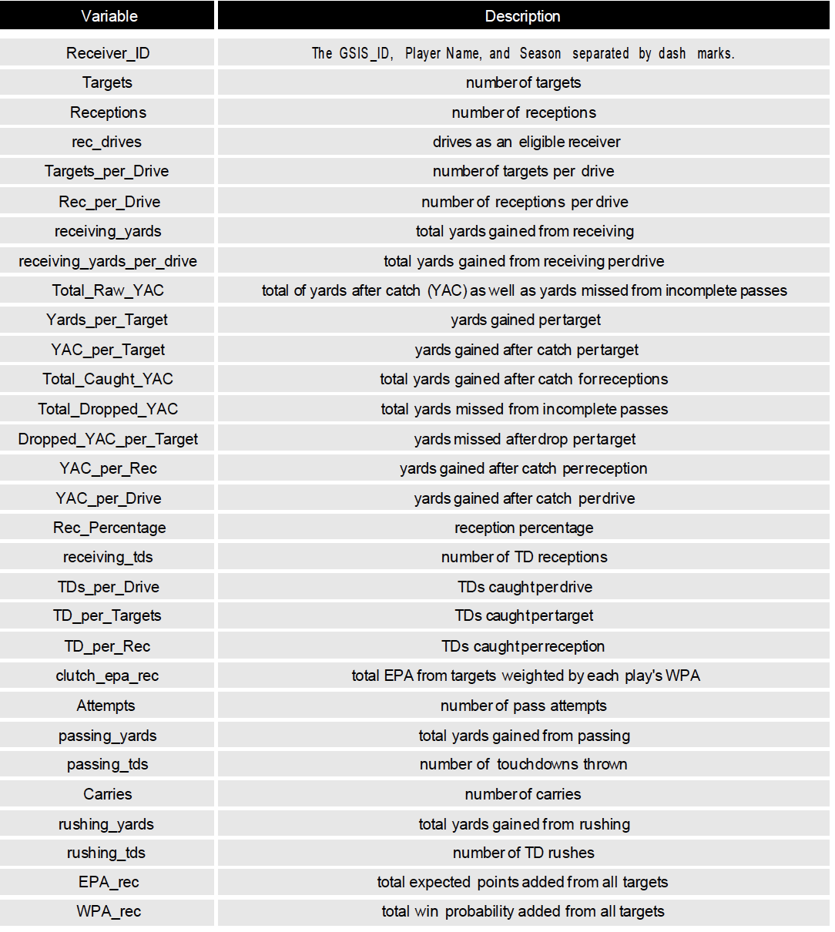
Wide Receiver Dataset
1,800 observations by 30 variables
Each observations is a player season
EX: 2015 Julio Jones is one observation
Spans from 2009-2017 seasons

Slide 8

Clustering Methodology
Chose Hierarchical Clustering with the ward method
Can handle multi-collinearity between predictors and is simple to interpret
Ran a Hopkins Test on each of the data sets to see if there were significant clusters
All datasets were able to reject the null which means that each of these datasets have statistically significant clusters
Had to decide how many clusters or in other words the amount of different player types there should be.
Used the elbow method, average silhouette method, and the gap-statistic method.
All methods gave varying results, but the results for each method seemed to average around 5 different clusters for all three of the datasets

Slide 9
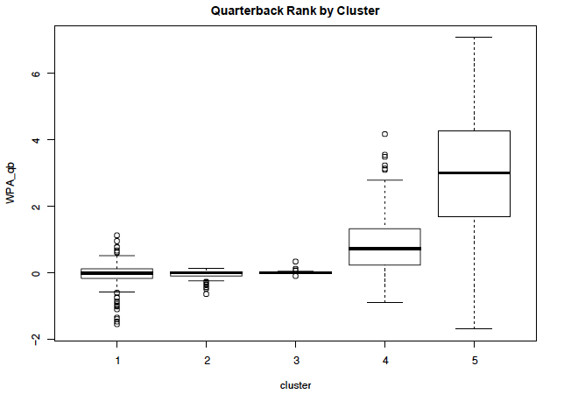
Result of Clusters vs WPA Quarterback
Clear Discrepancy between clusters (player types)
Notes:
Wpa_qb is total win probability added from pass attempts

Slide 10
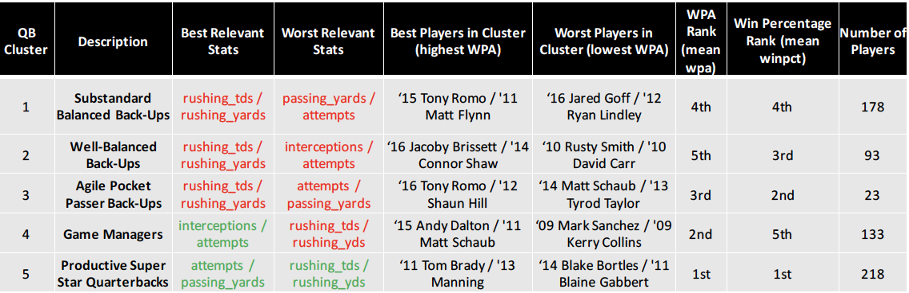
Description of Quarterback Clusters

Slide 11
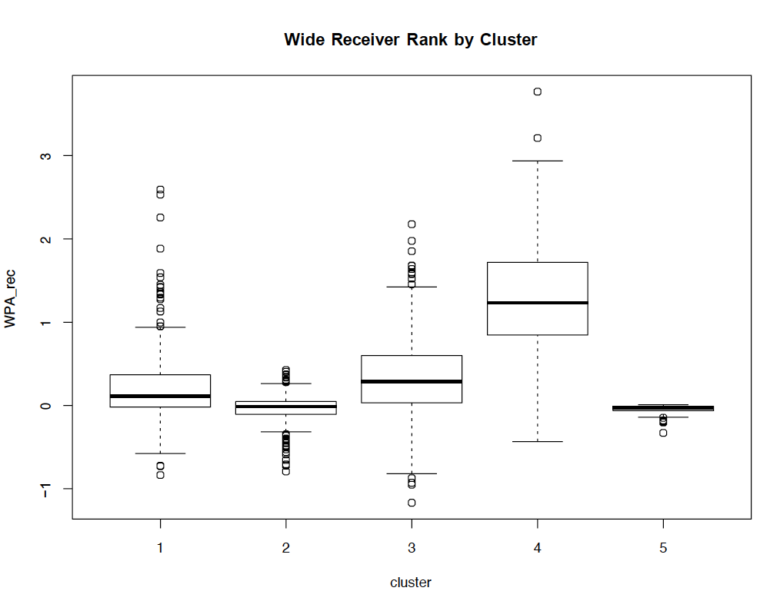
Result of Clusters vs WPA Wide Receiver
Clear Discrepancy between clusters (player types)

Slide 12
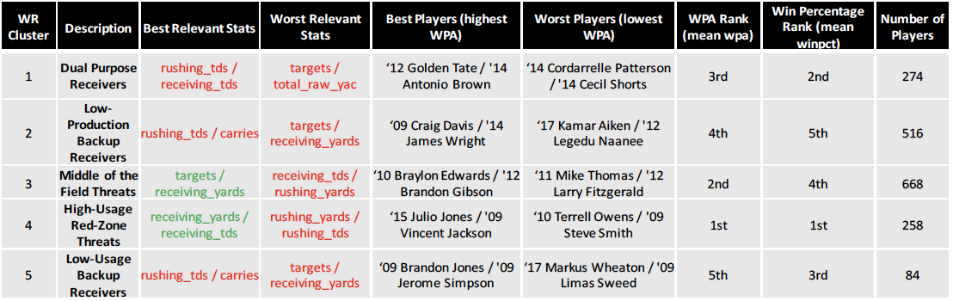
Description of Wide Receiver Clusters

Slide 13
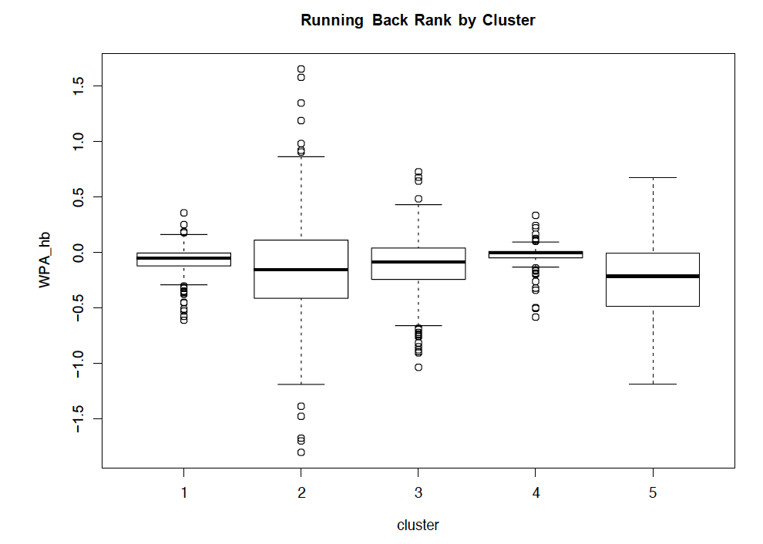
Result of Clusters vs WPA Running Back
No Clear Discrepancy between clusters (player types)
Notes:
Wpa_hb, total win probability added from all carries

Slide 14
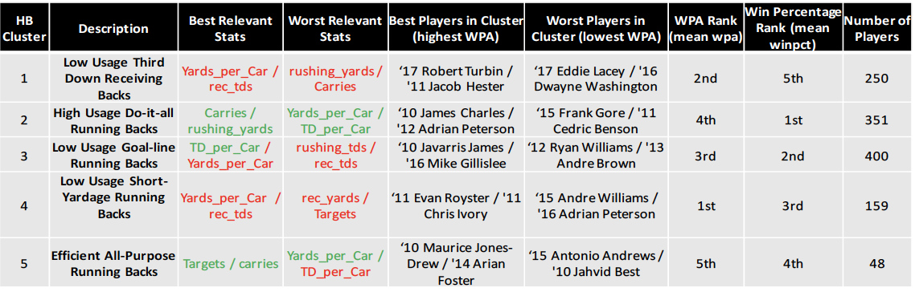
Description of running Back Clusters

Slide 15
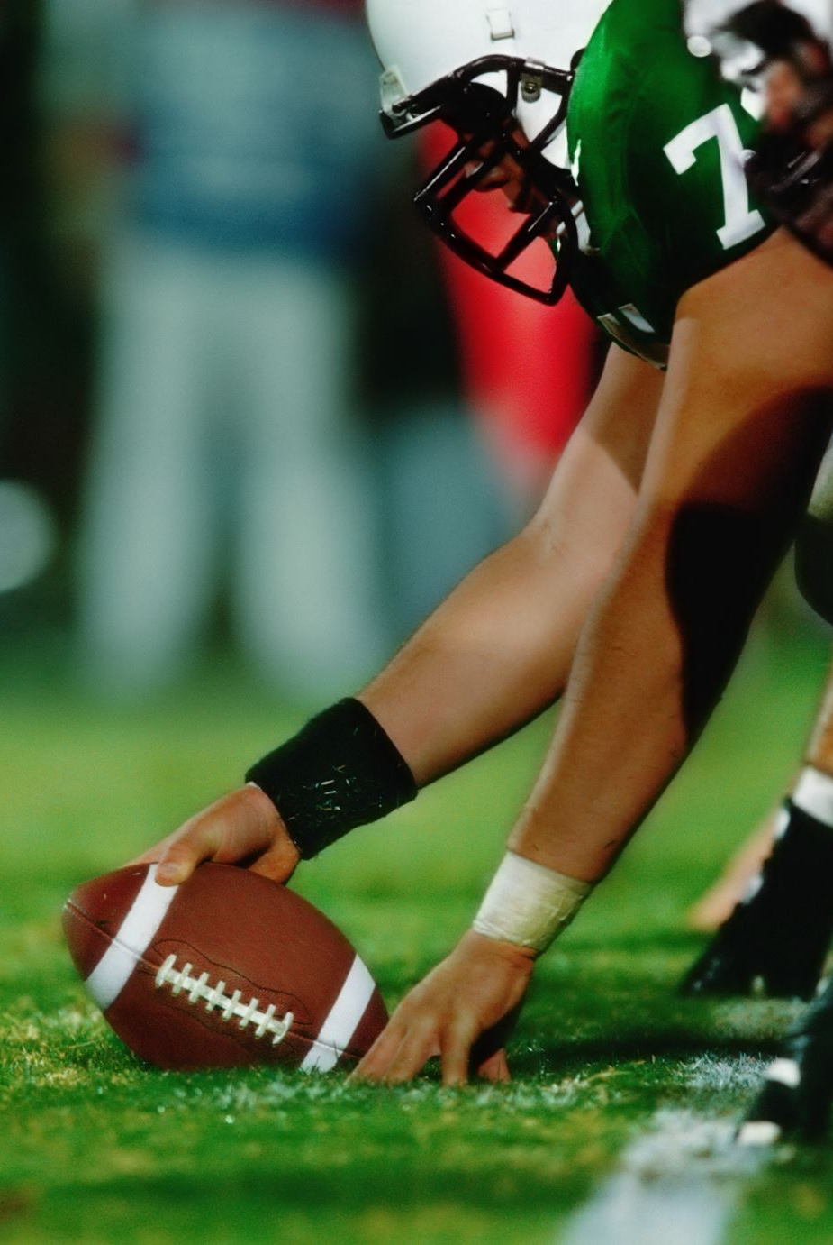
Conclusion
The idea of a running back not being as valuable as other offensive skilled positions seems to hold true
There wasn’t that big of a difference in average wpa from the different player types for running backs as there was in the other positions
Would like to create a filter to just look at players who play the most (snap count, etc.)
Could potentially capture different player types for just starters, which can lead to more in depth lineup optimization
Look at a different variable rather than just WPA
WPA only captures the win probability added from a carry, target, or pass attempt
Want a statistic that involves other aspects of the game (Ideally Win probability added from being on the field)

Slide 16

Contact Information
Email: apesante@nd.edu

